Slide 1
Chapter 6
Cognitive Development
Notes:
Add slide notes here

Slide 2
Piaget’s Constructivist Approach
Cognition: The activity of knowing and the processes through which knowledge is acquired and problems are solved
Common topics:
  Attention, Memory, Language, Perception
  Cognition == Thinking/Mental Processes
  Development: How do cognitive processes change over time?

Slide 3
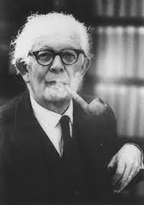
Studying Cognition in Children
Jean Piaget (1896 – 1980): Swiss psychologist who studied cognitive development in children
Much of his work used a clinical method
  Flexible question-and-answer technique used to discover how children think about problems
    Had children talk freely about their thoughts
Contemporary researchers consider this method imprecise because it does not involve asking standardized questions.
Notes:
Used interviews. Also studied his own kids

Slide 4
Piaget’s Theory -- Schemes
Schemes:
  Similar to having a set of rules or procedures that can be repeated and generalized across various situations
  During their second year, children develop symbolic schemes.
  Symbol use starts out deliberate, becomes automatic (Example: Reading)
    Older children manipulate symbols in their head.
Notes:
Piaget viewed children as little explorers or little scientists who use their schemes as a way to understand the world around them
Very simple example scheme: Objects can be picked up

Slide 5
How Does Cognition Develop? (1 of 3)
Piaget took interactionist perspective on nature–nurture:
  Children actively create knowledge by building schemes from their experiences (nurture), using two inborn intellectual functions (nature).
  Two Inborn Functions:
    Organization
      Children systematically combine existing schemes into new and more complex ones.
    Adaptation
      Process of adjusting to the demands of environment

Slide 6
How Does Cognition Develop? (2 of 3)
Adaptation:
  Occurs through two complementary processes:
    Assimilation
    Accommodation
  Assimilation
    Interpreting new experiences based on existing knowledge
    Fitting new information into existing schemes
  Accommodation
    Changing existing schemes to better fit new experiences

Slide 7
How Does Cognition Develop? (3 of 3)
Piaget thought that we are motivated to reduce conflict through equilibration.
  Process of achieving mental stability where internal thoughts are consistent with the evidence received from the external world
  Schemes should match the real world! Not always the case with young children!
Notes:
When kids are learning new information, their schemes don’t always match the real world.

Slide 8
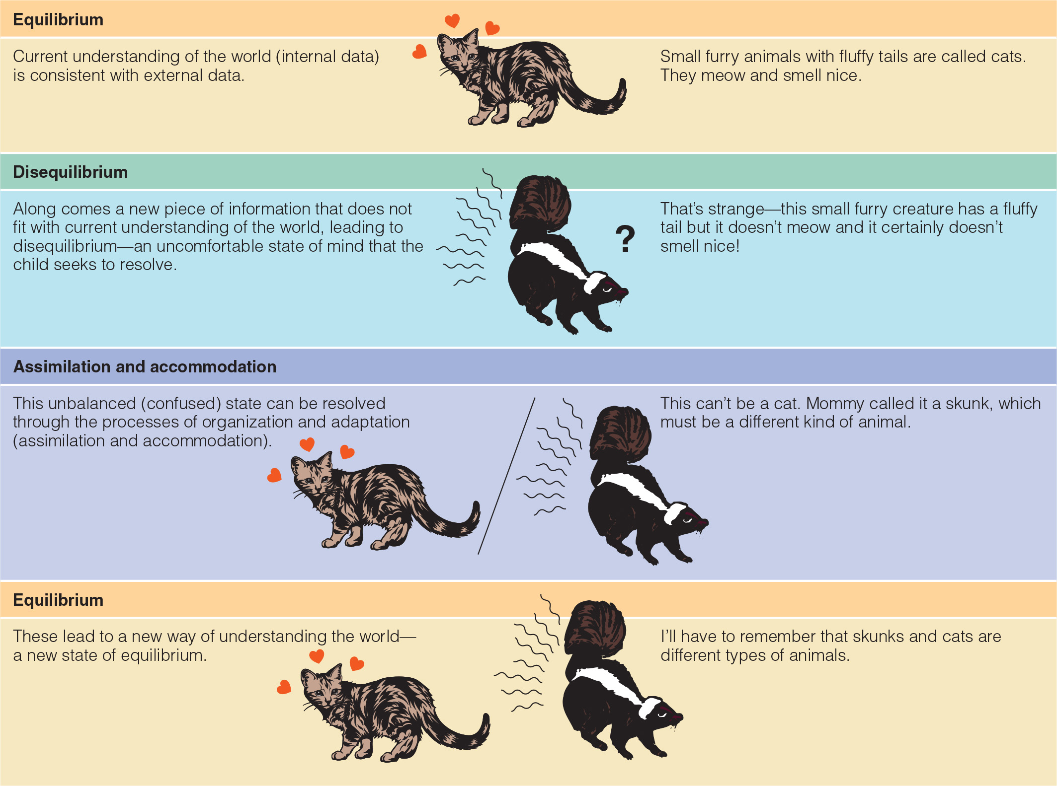
Process of Change in Jean Piaget’s Theory

Slide 9
Process of Change in Jean Piaget’s Theory

Slide 10
Process of Change in Jean Piaget’s Theory

Slide 11
Piaget’s Stages of Development
Piaget’s four distinct stages of cognitive development:
  The sensorimotor stage (birth to roughly 2 years)
  The preoperational stage (roughly 2–7 years)
  The concrete operations stage (roughly 7–11 years)
  The formal operations stage (roughly 11 years and beyond)

Slide 12
Symbols and Thought in Infancy (1 of 2)
Symbolic capacity:
  Ability to use images, words, or gestures to represent or stand for objects and experiences
  Most important cognitive achievement of infancy
Primary circular reactions:
  Infants repeating actions relating to their own bodies that had initially happened by chance
Secondary circular reactions:
  Infants derive pleasure from repeatedly performing an action, such as sucking or banging a toy.
  Occurs at 4–8 months

Slide 13
Symbols and Thought in Infancy (2 of 2)
Coordination of secondary schemes:
  Infants combine secondary actions to achieve simple goals.
  Occurs at 8–12 months
  Behavior starts to become intentional!
Final substage—beginning of thought:
  Evidence of symbolic capacity, where one object can be used to represent another
  Occurs about 18 months

Slide 14
Sensorimotor Reasoning in Infancy (2 of 3)
Object permanence: understanding that objects continue to exist outside of sensory awareness
Newborns lack an understanding of object permanence
  Fully developed ~ 15 months (but maybe earlier?)
A-not-B error:
  Tendency of 8- to 12-month-olds to search for an object in the place where they last found it (A) rather than in its new hiding place (B)
Notes:
Learning Objective: 6-2: Summarize Piaget’s six substages of sensorimotor reasoning and research findings on sensorimotor reasoning.
II. Sensorimotor Reasoning in Infancy
A. Mental representation: thinking about an object using mental pictures
B. Substage 1: Reflexes (Birth to 1 Month)
a. Infants use their reflexes (e.g., sucking and palmar grasp) to react to stimuli
b. At ~1 month, newborns begin to accommodate their sucking behaviors to specific objects
C. Substage 2: Primary Circular Reactions (1 to 4 Months)
a. Circular reactions: the repetition of an action and its response
b. Primary circular reactions: repeating actions involving the parts of the body that produce pleasurable or interesting results

Slide 15
Sensorimotor Reasoning in Infancy (3 of 3)
Tertiary Circular Reactions (12 to 18 Months)
  Tertiary circular reactions: active, purposeful, trial-and-error exploration to search for new discoveries and then vary actions to see how changes affect the outcomes
Mental Representation (18 to 24 months)
  Representational thought: ability to use symbols such as words and mental pictures to represent objects and actions in memory
Notes:
Learning Objective: 6-2: Summarize Piaget’s six substages of sensorimotor reasoning and research findings on sensorimotor reasoning.
II. Sensorimotor Reasoning in Infancy
A. Mental representation: thinking about an object using mental pictures
B. Substage 1: Reflexes (Birth to 1 Month)
a. Infants use their reflexes (e.g., sucking and palmar grasp) to react to stimuli
b. At ~1 month, newborns begin to accommodate their sucking behaviors to specific objects
C. Substage 2: Primary Circular Reactions (1 to 4 Months)
a. Circular reactions: the repetition of an action and its response
b. Primary circular reactions: repeating actions involving the parts of the body that produce pleasurable or interesting results

Slide 16
Piaget’s Stages of Development
Piaget’s four distinct stages of cognitive development:
  The sensorimotor stage (birth to roughly 2 years)
  The preoperational stage (roughly 2–7 years)
  The concrete operations stage (roughly 7–11 years)
  The formal operations stage (roughly 11 years and beyond)

Slide 17
Preoperational Reasoning in Early Childhood (1 of 3)
Preoperational reasoning (Ages 2-6)
  Characterized by dramatic leap in symbolic thinking that permits young children to use language, interact with others, and play using their own thoughts and imaginations to guide their behavior
  Operations: reversible mental actions (reasoning!)
Notes:
Learning Objective: 6-3: Discuss characteristics of preoperational reasoning and recent research on young children’s abilities.
III. Preoperational Reasoning in Early Childhood
A. Preoperational reasoning: appears in children from about ages 2–6 and is
characterized by dramatic leap in symbolic thinking that permits young
children to use language, interact with others, and play using their own thoughts
and imaginations to guide their behavior
B. Operations: reversible mental actions that limit preoperational reasoning in
children

Slide 18
Preschoolers: Symbolic Thinking (1 of 2)
Symbolic capacity:
  Greatest cognitive strength of preschoolers
    Use words to refer to things
    Can refer to past and future
    Pretend or fantasy play
  Associated with advanced cognitive and social development and higher levels of creativity

Slide 19
Preschoolers: Symbolic Thinking (2 of 2)
Preschoolers focus on perceptual salience:
  The most obvious features of an object or situation
  Preschoolers can be fooled by appearances.
  Have difficulty with tasks that require them to use logic

Slide 20
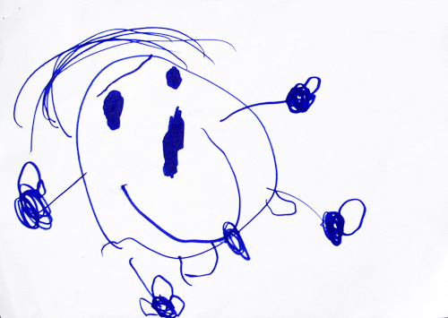

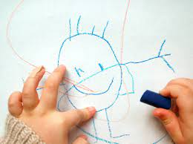

Children’s drawings of People
Why????

Slide 21
Preoperational Reasoning in Early Childhood (2 of 3)
Egocentrism: inability to take another person’s perspective
Notes:
Learning Objective: 6-3: Discuss characteristics of preoperational reasoning and recent research on young children’s abilities.
C. Characteristics of Preoperational Reasoning
a. Egocentrism
i. Egocentrism: the inability to take another person’s point of view or perspective
ii. Illustrated via the three-mountain task

Slide 22


Slide 23
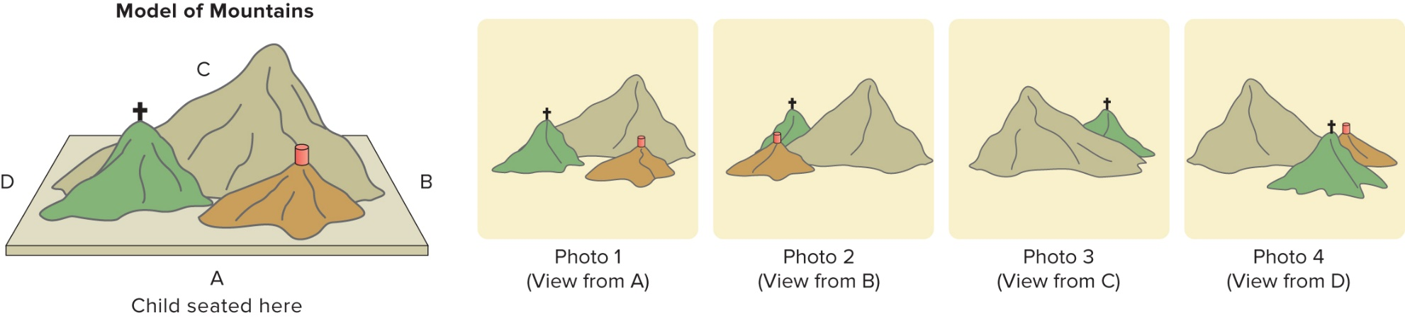
The Three Mountains Task (2 of 2)
Adult sitting at C?

Slide 24
Preoperational Reasoning in Early Childhood (3 of 3)
Animism: belief that inanimate objects are alive and have feelings and intentions
Centration: tendency to focus on one part of a stimulus or situation and exclude all others
Appearance-reality distinction: task that requires preoperational child to distinguish what something appears to be from what it really is
Notes:
Learning Objective: 6-3: Discuss characteristics of preoperational reasoning and recent research on young children’s abilities.
b. Animism
i. Animism: the belief that inanimate objects are alive and have feelings and intentions
ii. Children accept their own explanations for phenomena
c. Centration
i. Centration: the tendency to focus on one part of a stimulus or situation and exclude all others
ii. Appearance–reality distinction: a task that requires the preoperational
child to distinguish what something appears to be from what it really is
1. Study with cat named Maynard
2. Study with a scale model

Slide 25
Concrete Operational Reasoning in Middle Childhood
Classification: understanding hierarchies, considering relations between a category and subcategories
Transitive inference: inferring the relationship between two objects by understanding each object’s relationship to a third
Seriation: ordering objects in a series according to a physical dimension
Notes:
Learning Objective: 6-4: Describe concrete operational reasoning and research findings on older children’s abilities.
IV. Concrete Operational Reasoning in Middle Childhood
A. Concrete operational stage of reasoning: the stage at about 6 or 7 when children become able to use operations (reversible mental actions) to solve problems
B. Classification
a. Classification: the ability to understand hierarchies, to simultaneously consider relations between a category and more specific subcategories
i. Transitive inference: the ability to infer the relationship between two objects by understanding each object’s relationship to a third
ii. Seriation: the ability to order objects in a series according to a physical dimension such as height, weight, or color
iii. Class inclusion: the understanding of hierarchical relationships among items

Slide 26
Piaget’s Stages of Development
Piaget’s four distinct stages of cognitive development:
  The sensorimotor stage (birth to roughly 2 years)
  The preoperational stage (roughly 2–7 years)
  The concrete operations stage (roughly 7–11 years)
  The formal operations stage (roughly 11 years and beyond)

Slide 27
Formal Operational Reasoning in Adolescence (1 of 2)
Final stage of Piaget’s cognitive-developmental theory
  ~11 years
  Can reason about ideas and imagined problems
Hypothetical-deductive reasoning: ability to consider problems, generate and systematically test hypotheses, and draw conclusions
Notes:
Learning Objective: 6-5: Analyze the development of formal operational reasoning in adolescence and its role in social cognition.
V. Formal Operational Reasoning in Adolescence
A. Formal operational reasoning: the final stage of Piaget’s cognitive-developmental theory, emerging in early adolescence at about 11 years, where adolescents can reason about ideas and imagined problems
B. Characteristics of Formal Operational Reasonings
a. Entails the ability to think abstractly, logically, and systematically
b. Reason about things (concepts that exist in reality) and ideas (possibilities that have no tangible substance)
d. Hypothetical-deductive reasoning: the ability to consider problems, generate and systematically test hypotheses, and draw conclusions

Slide 28
Formal Operational Reasoning in Adolescence (2 of 2)
Social cognition: how adolescents think about other people, relationships, and the social world
  Mutual perspective taking: adolescents become aware they take other people’s point of view and others attempt to take their point of view
  Societal perspective taking: adolescents recognize the social environment influences perspectives and beliefs
Adolescents have difficulty distinguishing their view of what others think of them from reality
  Imaginary audience: feeling that all eyes are on you
  Personal fable: believing you are special, unique, and invulnerable
Notes:
Learning Objective: 6-5: Analyze the development of formal operational reasoning in adolescence and its role in social cognition.
C. Social Cognition in Adolescence
a. Social cognition: how adolescents think about other people, relationships, and the social world
b. Perspective Taking
i. Mutual perspective taking: the process when young adolescents become aware that they take other people’s point of view at the same time as others attempt to take their own point of view (ages 10-12)
ii. Societal perspective taking: the process when adolescents recognize that the social environment, including the larger society, influences people’s perspectives and beliefs (ages 12-15)
c. Adolescent Egocentrism
i. Adolescents find it difficult to distinguish their view of what others think of them from reality, what others actually think about them
ii. Imaginary audience: an error in perspective taking that is experienced as self-consciousness and the feeling that all eyes are on you
iii. Personal fable: an error in perspective taking in which adolescents believe that they are special, unique, and invulnerable
iv. Adolescent egocentrism may peak around age 19 and decline after
v. Social media may change these developments, as the imaginary audience becomes less imaginary

Slide 29
Limitations in Adult Cognitive Performance
Adults:
  Likely to use formal operations in a field of expertise
  Use concrete operations in less familiar areas.
Performance
  Likely to be highly inconsistent across content areas unless the person has had a chance to build knowledge and skills

Slide 30
Piaget’s Contributions
Asked important questions that continue to guide the study of cognitive development
Showed us that infants and children are active in their own development
Taught us that young people think differently than older people do
Was largely accurate in his basic description of cognitive development

Slide 31
Challenges to Piaget
Four common criticisms:
  Underestimating cognitive abilities of infants and young children
  Wrongly claiming that broad stages of development exist
  Failing to adequately explain development
    Did a better job describing development than explaining how it comes about
  Giving limited attention to social influences on cognitive development
    He did not believe that children learned much from their interactions with adults.

Slide 32
Vygotsky’s Sociocultural Theory
Sociocultural theory—we are embedded in a context that shapes how we think and who we become
  Guided participation (apprenticeship in thinking): Adult is attuned to the needs of the child.
    Helps them to accomplish more than they could do alone
  Scaffolding: assistance tailored to children’s needs
    enables children to bridge the gap between current competence level and the task at hand.
Notes:
Learning Objective: 6-6: Discuss Vygotsky’s sociocultural perspective on cognitive development.
VI. Vygotsky’s Sociocultural Theory
A. Sociocultural theory—we are embedded in a context that shapes how we think and who we become
B. Learning comes from collaborating with skilled partners who provide guidance
C. Guided Participation and Scaffolding
a. Guided participation (apprenticeship in thinking): a form of sensitive teaching in which one partner is attuned to the needs of the child and helps them to accomplish more than the child could do alone
b. Scaffolding: assistance that is tailored to children’s needs and enables children to bridge the gap between their current competence level and the task at hand
c. Quality of scaffolding influences children’s development
d. Scaffolding occurs informally (any time more skilled persons adjust their interactional style to guide someone to complete a task they could not complete alone) and formally (educational settings)

Slide 33
Social Interaction and Thought (1 of 3)
Zone of proximal development:
  The gap between what a learner can accomplish independently and what he or she can accomplish with the guidance and encouragement of a more-skilled partner
  Skills within the zone
    Skills at which instruction should be aimed
  Skills outside the zone
    Either well mastered or still too difficult

Slide 34
Social Interaction and Thought (2 of 3)
Implication of the zone of proximal development:
  Knowledge is not a fixed state.
  No single test or score can adequately reflect the range of a person’s knowledge.
  Development consists of moving toward the upper range of the zone.

Slide 35
Social Interaction and Thought (3 of 3)
To Piaget
  Child’s level of cognitive development determines what he can learn.
To Vygotsky
  Learning in collaboration with more knowledgeable companions drives cognitive development.

Slide 36
Language and Thought
Vygotsky argued that:
  Language shapes thought.
  Thought changes fundamentally once we begin to think in words.
  Preschool children use private speech.
    Speech to oneself that guides one’s thought and behavior
    Critical step in the development of mature thought
    Forerunner of the silent thinking-in-words adults use

Slide 37
Evaluating Vygotsky’s Theory
Vygotsky’s theories have been applied in educational settings
Vygotsky’s ideas have been criticized for being too vague in the key definitions of core concepts and thus untestable; he also did not address all areas of cognition
Since Vygotsky died at 37, his theory is also incomplete
Notes:
Learning Objective: 6-6: Discuss Vygotsky’s sociocultural perspective on cognitive development.
F. Evaluating Vygotsky’s Sociocultural Perspective
a. Vygotsky’s theories have been applied in educational settings
b. Vygotsky’s ideas have been criticized for being too vague in the key definitions of core concepts and thus untestable; he also did not address all areas of cognition
c. Since Vygotsky died at 37, his theory is also incomplete

Slide 38
Table 6.1 A Comparison of Vygotsky and Piaget
Vygotsky’s Sociocultural View | Piaget’s Cognitive Developmental View
Processes of animal and human development are fundamentally different. | Processes of animal and human development are fundamentally the same.
Cognitive development is different in different social and historical contexts. | Cognitive development is mostly the same universally.
Appropriate unit of analysis is the social, cultural, and historical context in which the individual develops. | Appropriate unit of analysis is the individual.
Cognitive growth results from social interactions. | Cognitive growth results from the child’s independent explorations of the world.
Children and their partners co-construct knowledge. | Children construct knowledge on their own.
Social processes become individual psychological ones. | Individual, egocentric processes become more social.
Adults are especially important because they know the culture’s tools of thinking. | Peers are especially important because the cognitive conflict triggered by different perspectives of other children is not so overwhelming that it cannot be resolved.
Learning precedes development. | Development precedes learning.
Training can help mediate development. | Training is largely ineffective in “speeding up” development.
Notes:
Table 7.1 A Comparison of Vygotsky and Piaget

Slide 39
Growth Beyond Formal Operations?
Postformal thought
  More complex than formal-operational stage
Relativistic thinking
  Knowledge depends on its context and the subjective perspective of the knower.
Dialectical thinking
  Detecting paradoxes and inconsistencies among ideas and trying to reconcile them

Slide 40
Aging and Cognitive Skills
Some mental abilities decline as the average person ages.
Other explanations:
  Cohort effect
  May be differences in style
  Lack of motivation

